Slide 1
Biological Control of WeedsBiological Weeds
Possible reasons for the success of invasive plants Possible plants
More favorable climatic conditions
Less competitive environment
Lack of natural enemies
Genetic differences/changes

Slide 2
Factors influencing invasive Plants
Environment
Arthropods
Biotic potential
WEEDS
Pathogens
Intraspecific competition
Interspecific competition

Slide 4
Definition of Biological Control
The action of parasites, predators and pathogens in maintaining another organism’s density at a level lower then would occur in their absence
The activity of one (or more) species that reduces the adverse effects of another species

Slide 5
Biological Control Types
•Inundative
–mass-release of beneficial organisms
•Classical (Inoculative)
–introduction of non-native beneficial organisms
•Conservation
–management practices to favor beneficial organisms

Slide 6
ClassicalBiological Control of Weeds Definition
„The introduction of control agents into a region, that is not part of their natural range, to suppress permanently the populations of selected target weeds usually also introduced into that region“
Harley and Forno 1992, McFadyen 1998, modified.

Slide 7
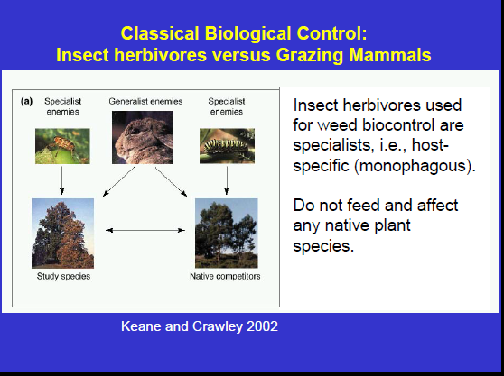

Slide 8
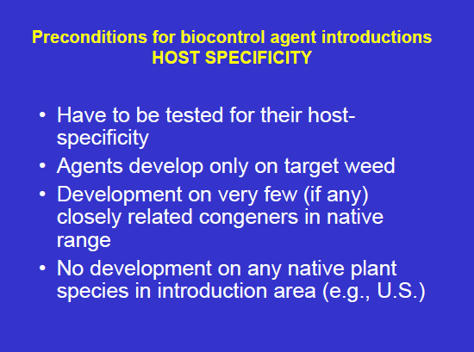

Slide 9
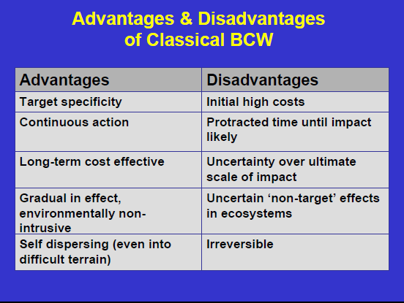

Slide 10
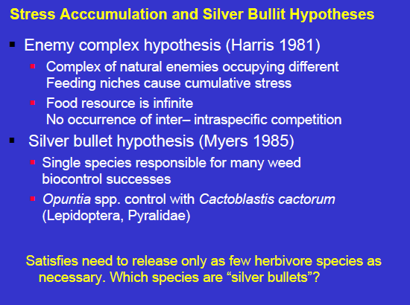

Slide 11
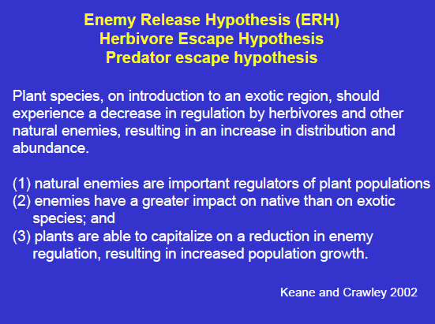

Slide 12
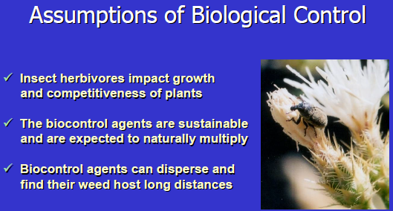
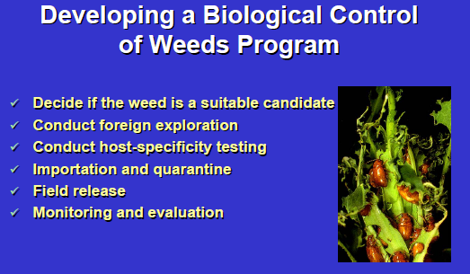

Slide 13
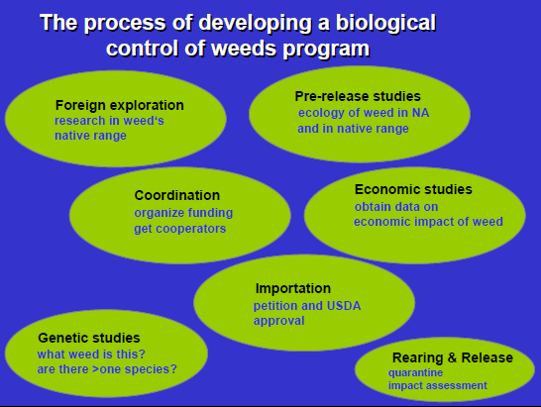

Slide 14
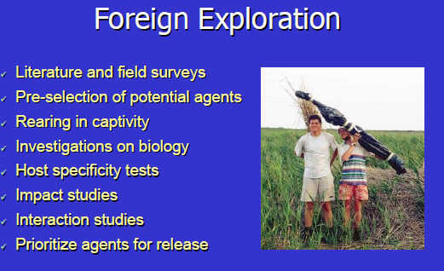
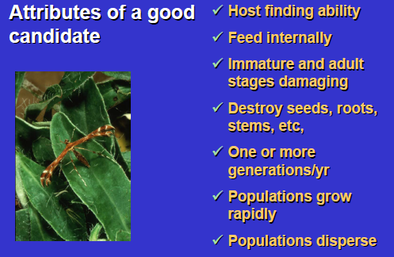

Slide 15

Definition of a weed:
A weed is an undesired plant out of place
Water hyacinth in a aquatic garden: not a weed
Water hyacinth clogging canals: a weed

Slide 16
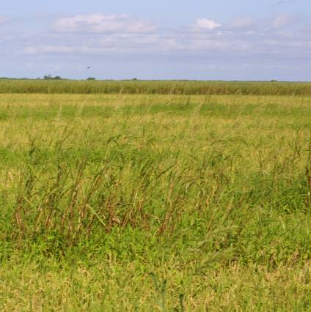
Weed impacts
Weeds are costly
$24 billion in agricultural crop loss
$3 billion in control costs
Pimentel et al. 1999

Slide 17
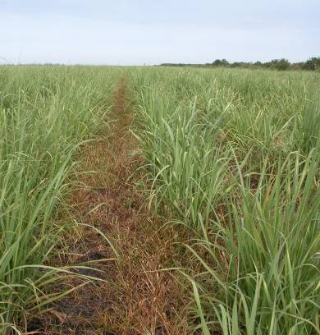
Weeds are costly
It is estimated that without control, sugarcane losses would be 50% from heavy infestations of fall panicum
In 2000, over $51 million was spent for weed control in US sugarcane

Slide 18
Why do weeds always win?
Dormancy: broken when conditions favor survival
Rapid early growth and expansion
Early and fast root growth
Efficient uptake and processing of nutrients and water

Slide 19
Why do weeds always win?
Ability to reproduce early in life cycle
Prolific seed production
Absorb resources in excess
Tolerate low levels of resources
Genetic and environmental adaptability
Ability to develop resistance to control measures

